Slide 1


Francisco
8/14/24

Slide 2

Outline
Executive Summary
Introduction
Methodology
Results
Conclusion
Appendix

Slide 3
Executive Summary
Summary of methodologies
Data collection
Data wrangling
EDA – Exploratory data analysis with SQL and visualization
Interactive visual analytics with Folium and Plotly Dash
Predictive analysis using classification models
Summary of all results
Exploratory data analysis results
Exploratory data analysis results
Predictive analysis results

Slide 4
Introduction
Project background and context
SpaceX advertises Falcon 9 rocket launches on its website with a cost of 62 million dollars; other providers cost upward of 165 million dollars each, much of the savings is because SpaceX can reuse the first stage. Therefore if we can determine if the first stage will land, we can determine the cost of a launch. This information can be used if an alternate company wants to bid against SpaceX for a rocket launch.
Problems to find answers
Determine if Stage 1 will land successfully or not depending on variables such as payload mass, launch site, booster, etc.
Find out which feature has the most influence on the result.
Best algorithm for prediction.

Slide 5

Section 1

Slide 6
Methodology
Executive Summary
Data collection methodology:
Request and parse the SpaceX launch data using the GET request on API and web.
Perform data wrangling
Missing values were replaced, and landing outcomes were converted to classes (0 or 1)
Perform exploratory data analysis (EDA) using visualization and SQL
Perform interactive visual analytics using Folium and Plotly Dash
Perform predictive analysis using classification models
How to build, tune, evaluate classification models

Slide 7
Data Collection
Data Collection – SpaceX API
First, we get the information through the Spacex API with the GET request method. Then we decode the response content as a Json using .json() and turn it into a Pandas dataframe using .json_normalize().
Data Collection - Scraping
Here, we perform web scraping to collect Falcon 9 historical launch records from a Wikipedia page titled List of Falcon 9 and Falcon Heavy launches. First, we use the GET request method and then the library BeautifulSoap was used to parse the html response. With the parse we obtained the desired table.

Slide 8
Data Collection – SpaceX API
GET request to the SpaceX API
Decode the response content as a Json using .json()
Turn it into a Pandas dataframe using
.json_normalize()
Data cleaning and replace missing values
GitHub URL of the completed SpaceX API calls notebook

Slide 9
Data Collection - Scraping
GET request to Wikipedia page
Create a BeautifulSoup object from the HTML response
Extract all column/variable names from the HTML
Create a data frame by parsing the launch HTML tables
GitHub URL of the completed web scraping notebook

Slide 10
Data Wrangling
We performed an exploratory data analysis (EDA) and calculated some important data.
Then, we created a CSV file with the selected data.
EDA – Exploratory data analysis
Calculate the number of launches on each site
Calculate the number and occurrence of each orbit
Create a landing outcome label from Outcome column
Export data into CSV
GitHub URL of the completed data wrangling notebook

Slide 11
EDA with Data Visualization
We plotted the followings types of charts:
Catplot: to see how the FlightNumber (indicating the continuous launch attempts.) and Payload/Launch site variables would affect the launch outcome. Also, to visualize the relationship between “Payload Mass and Launch Site”, “FlightNumber and Orbit type” and “Payload Mass and Orbit type”.
Barplot: to visualize the relationship between success rate of each orbit type.
Line chart: to visualize the launch success yearly trend.
GitHub URL of the completed EDA with data visualization notebook

Slide 12
EDA with SQL
The SQL queries were:
Display the names of the unique launch sites in the space mission.
Display 5 records where launch sites begin with the string ‘CCA’.
Display the total payload mass carried by boosters launched by NASA (CRS).
Display average payload mass carried by booster version F9 v1.1.
List the date when the first succesful landing outcome in ground pad was achieved.
List the names of the boosters which have success in drone ship and have payload mass greater than 4000 but less than 6000.
List the total number of successful and failure mission outcomes.
List the names of the booster_versions which have carried the maximum payload mass. Use a subquery.
List the records which will display the month names, failure landing_outcomes in drone ship ,booster versions, launch_site for the months in year 2015.
Rank the count of landing outcomes (such as Failure (drone ship) or Success (ground pad)) between the date 2010-06-04 and 2017-03-20, in descending order.
GitHub URL of the completed EDA with SQL notebook

Slide 13
Build an Interactive Map with Folium
Objects added to the folium map:
Circle and marker at Launch sites coordinates with a popup label showing their names.
Markers clusters.
Lines to indicate distance between different places.
Markers to indicate the outcome of the landing.
GitHub URL of the completed interactive map with Folium map notebook

Slide 14
Build a Dashboard with Plotly Dash
Plots and interactions used in the dashboard:
Dropdown list to select a launch site.
Pie plot to compare the success of the mission.
Scatter plot: Outcome of the mission vs Payload mass.
Range slider for the scatter plot to change the Payload mass range.
GitHub URL of the completed interactive Plotly Dash lab notebook

Slide 15
Predictive Analysis (Classification)
First, we loaded the dataframe and then we standardized the data. Then, we apply each method of classification using GridSearchCV.
Finally, we compare each method score to find the best performing classification model.
Create a NumPy array from the column Class
Standardize the data in X
Use the function train_test_split to split the data X and Y
Create a logistic regression object then create a GridSearchCV object logreg_cv
Calculate the accuracy on the test data using the method score
Create a support vector machine object then create a GridSearchCV object svm_cv
Calculate the accuracy on the test data using the method score
Create a decision tree classifier object then create a GridSearchCV object tree_cv
Calculate the accuracy of tree_cv on the test data using the method score
Create a k nearest neighbors object then create a GridSearchCV object knn_cv
Calculate the accuracy of knn_cv on the test data using the method score
Find the method performs best
GitHub URL of the completed predictive analysis lab notebook

Slide 16
Results
Exploratory data analysis results
Interactive analytics demo in screenshots
Predictive analysis results

Slide 17

Section 2

Slide 18
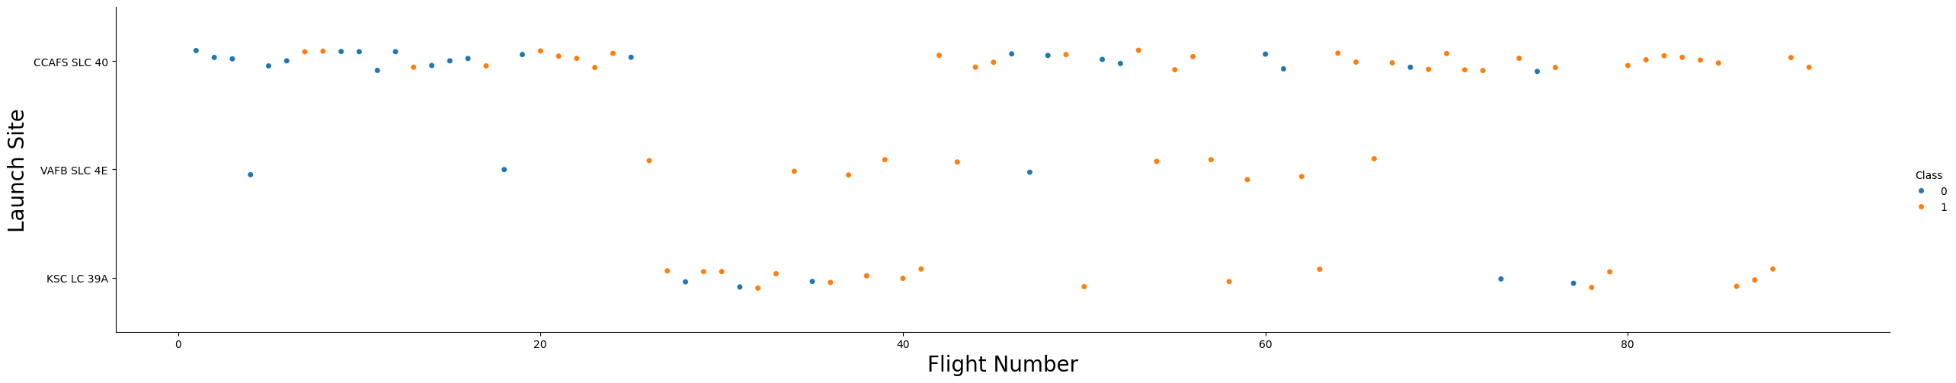
Flight Number vs. Launch Site
We see that as the flight number increases, the first stage is more likely to land successfully at all launch sites.

Slide 19
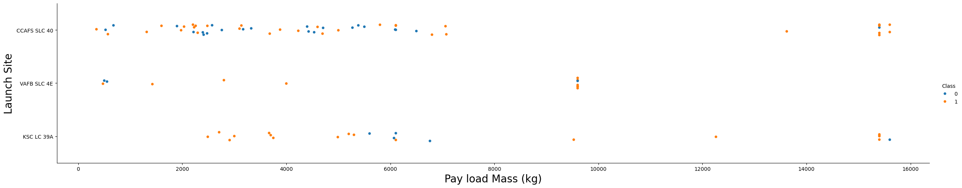
Payload vs. Launch Site
Now if we observe Payload Mass Vs. Launch Site scatter point chart you will find for the VAFB-SLC launch site there are no rockets launched for heavy payload mass(greater than 10000).

Slide 20
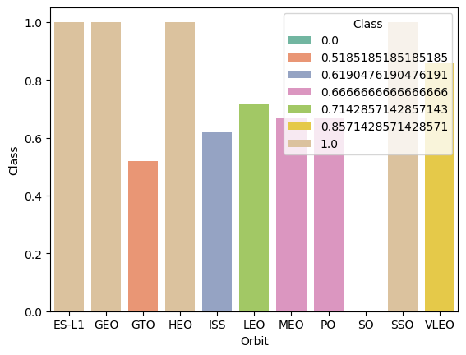
Success Rate vs. Orbit Type
ES-L1, GEO, HEO and SSO have the most successful rate

Slide 21
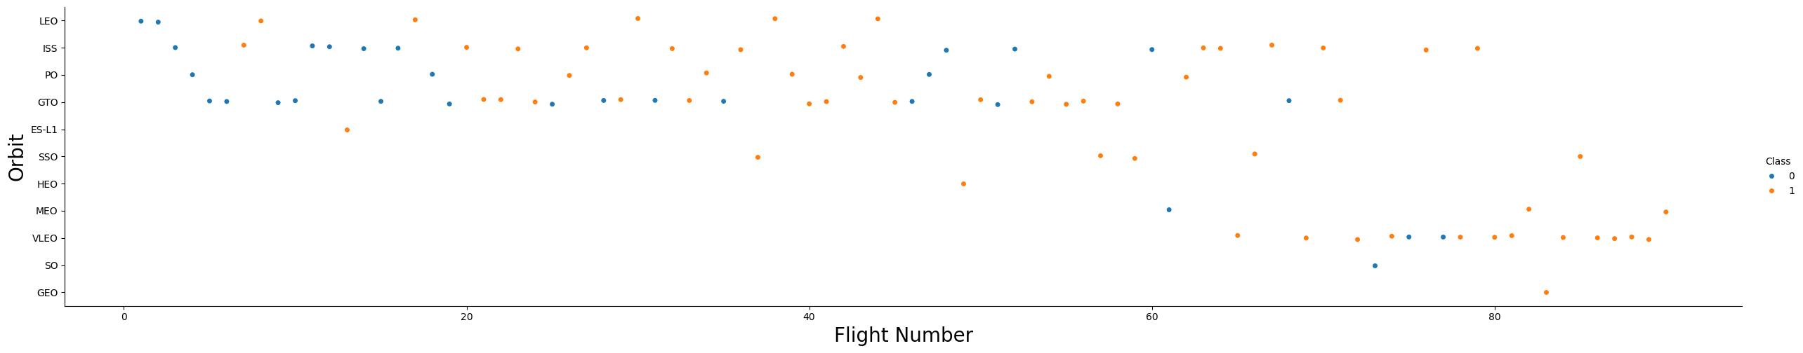
Flight Number vs. Orbit Type
We can observe that in the LEO orbit, success seems to be related to the number of flights. Conversely, in the GTO orbit, there appears to be no relationship between flight number and success

Slide 22
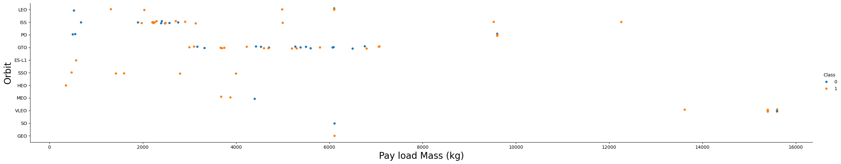
Payload vs. Orbit Type
With heavy payloads the successful landing or positive landing rate are more for Polar,LEO and ISS.
However, for GTO, it's difficult to distinguish between successful and unsuccessful landings as both outcomes are present

Slide 23
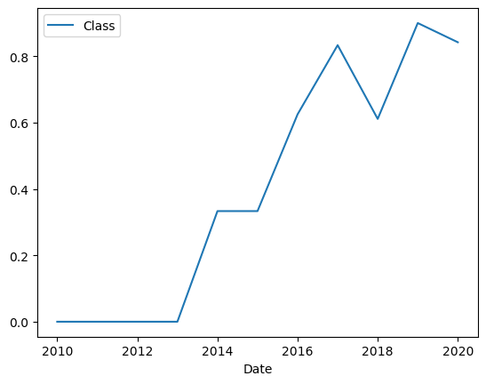
Launch Success Yearly Trend
You can observe that the success rate since 2013 kept increasing till 2020

Slide 24
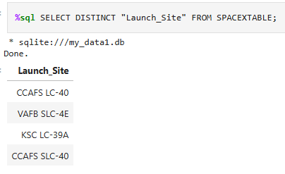
All Launch Site Names
Display the names of the unique launch sites in the space mission

Slide 25
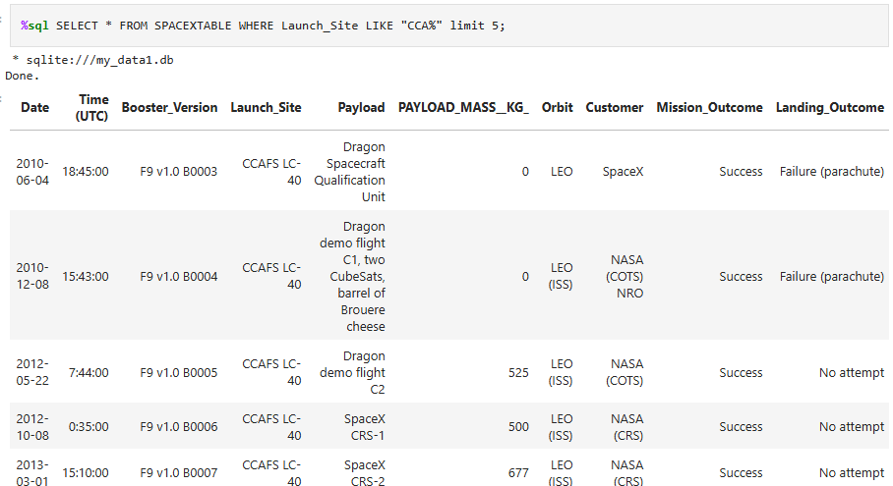
Launch Site Names Begin with 'CCA'
Display 5 records where launch sites begin with the string 'CCA'

Slide 26
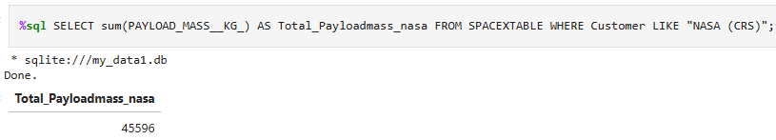
Total Payload Mass
Display the total payload mass carried by boosters launched by NASA (CRS)

Slide 27
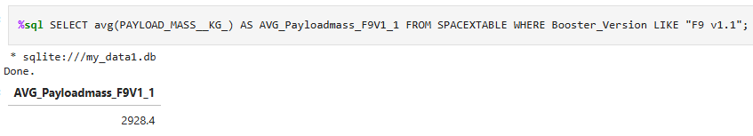
Average Payload Mass by F9 v1.1
Display average payload mass carried by booster version F9 v1.1

Slide 28
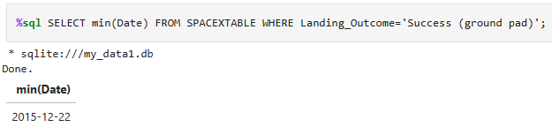
First Successful Ground Landing Date
List the date when the first successful landing outcome in ground pad was achieved.

Slide 29
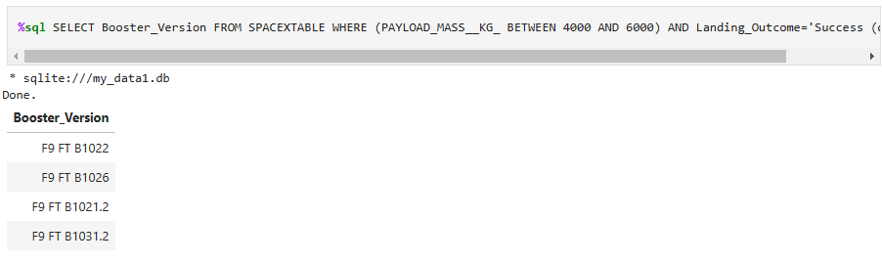
Successful Drone Ship Landing with Payload between 4000 and 6000
List the names of the boosters which have success in drone ship and have payload mass greater than 4000 but less than 6000

Slide 30
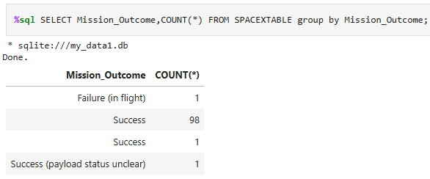
Total Number of Successful and Failure Mission Outcomes
List the total number of successful and failure mission outcomes

Slide 31
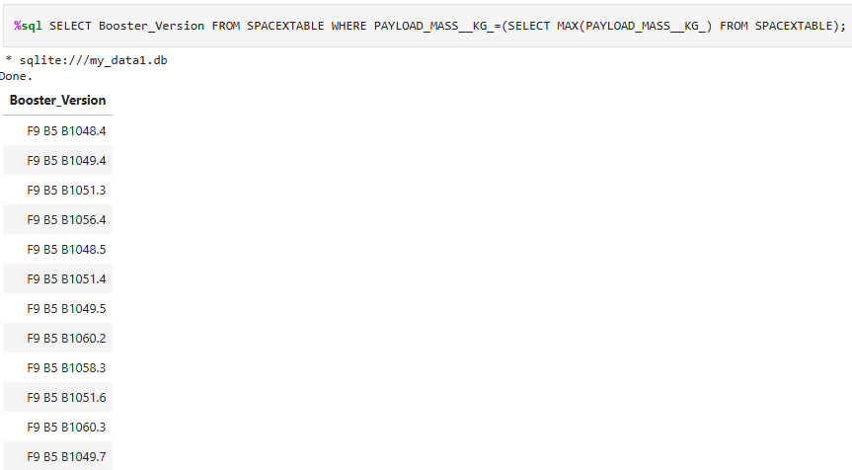
Boosters Carried Maximum Payload
List the names of the booster_versions which have carried the maximum payload mass.

Slide 32
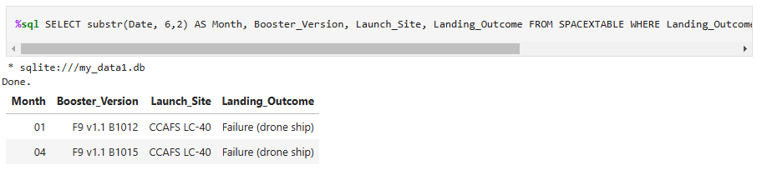
2015 Launch Records
List the records which will display the month names, failure landing_outcomes in drone ship ,booster versions, launch_site for the months in year 2015.

Slide 33
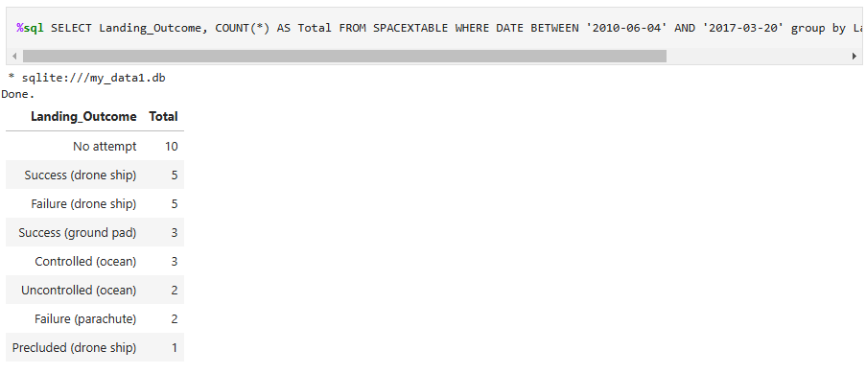
Rank Landing Outcomes Between 2010-06-04 and 2017-03-20
Rank the count of landing outcomes (such as Failure (drone ship) or Success (ground pad)) between the date 2010-06-04 and 2017-03-20, in descending order.

Slide 34

Section 3

Slide 35
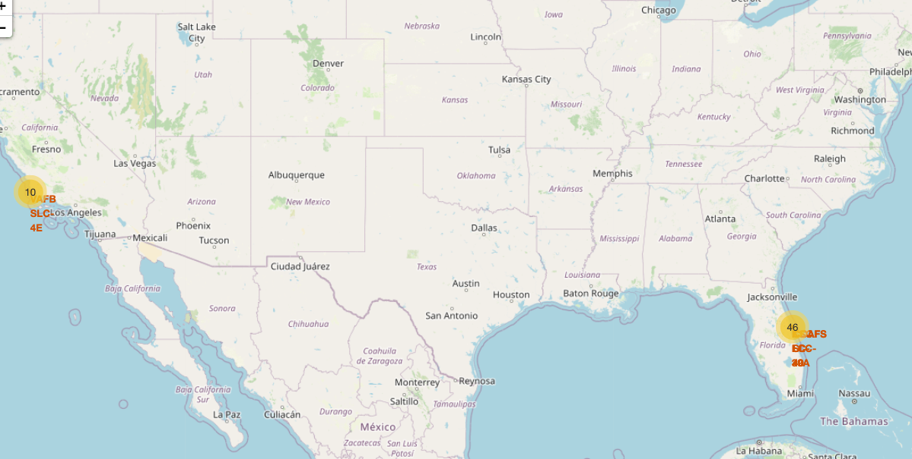
Global map and launch sites
The most launches were made at the east coast.

Slide 36
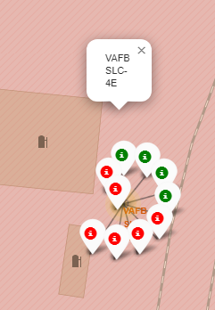
Outcomes at VAFB SLC-4E
At this launch site there are more unsuccessful lands than successful.

Slide 37
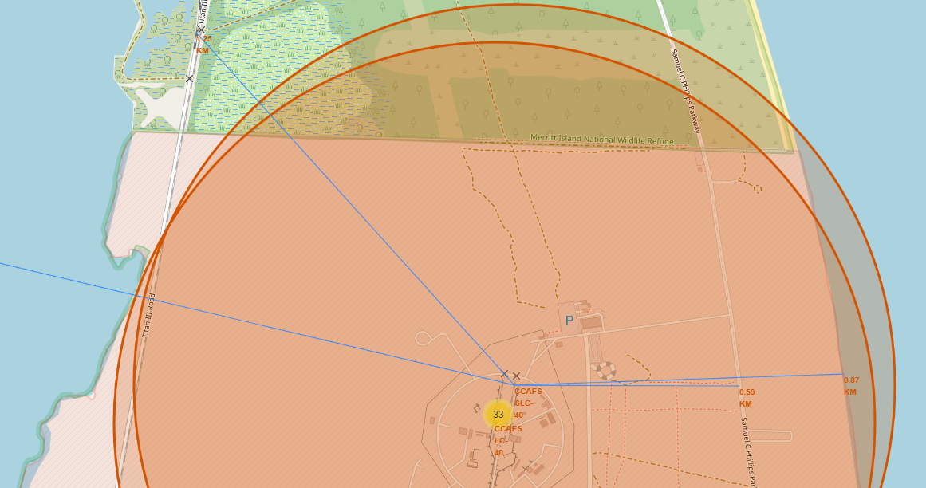
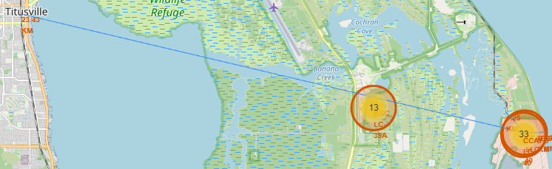
Distance between a launch site an places
Distance from CCAFS SLC-40 to:
Coast: 0.87 km
Highway: 0.59 km
Railway: 1.25 km
Titusville: 23.43 km

Slide 38

Section 4

Slide 39
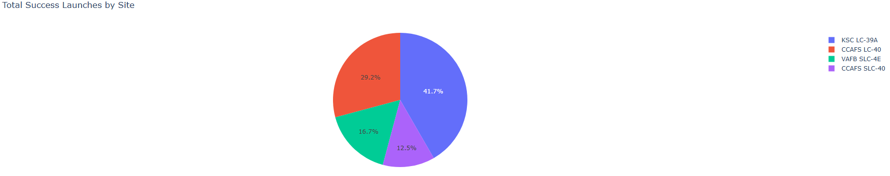
Total success launches by site
The most successful launch site is KSC LC-39A

Slide 40
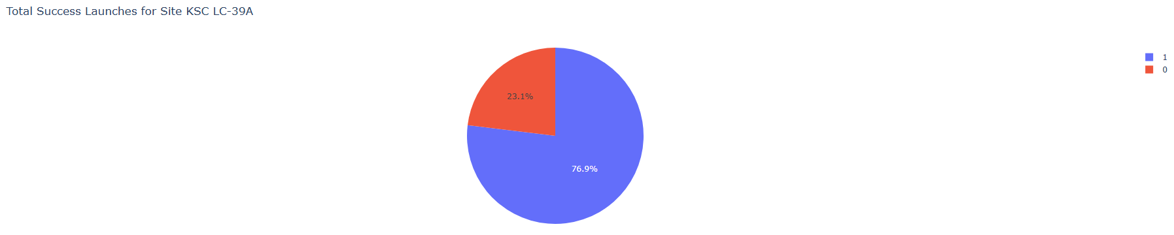
Total success launches for site KSC LC-39A
The success rate is 76.9% for KSC LC-39A

Slide 41
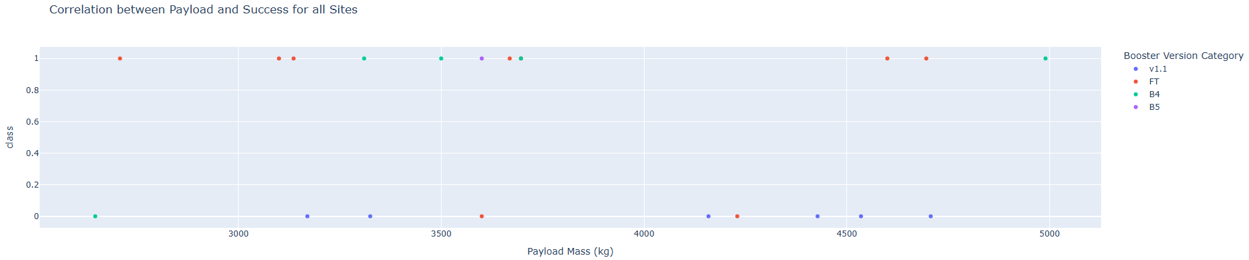

<Dashboard Screenshot 3>
The payload between 2500 kg and 5000 kg are more successful than the ones between 5000 kg and 7500 kg.

Slide 42

Section 5

Slide 43
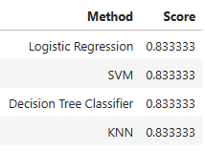
Classification Accuracy
The accuracy of all models are the same.
We can infer that the decision tree classifier will have the best accuracy in the real world because it has the best model score (0.9).

Slide 44
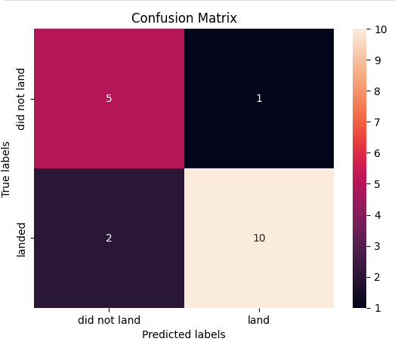
Confusion Matrix
We can se that the TN and TP are higher than FN and FP.
That indicates that the model classifies in a correct way the test data.

Slide 45
Conclusions
As the flight number increases, the first stage is more likely to land successfully at all launch sites.
Orbits ES-L1, GEO, HEO and SSO have the most successful rate.
The success rate since 2013 kept increasing till 2020
The most launches were made at the east coast.
The most successful launch site is KSC LC-39A
Decision tree classifier is the best method to fit the data

Slide 46


